Slide 1


Looking in depth overview of eXplainable AI methods
Host Tonight: DIGIT Games Studio
Date : 20/06/2023

Slide 2

Overview of the talk concept of eXplainable (XAI) AI
Right to explanation
Need for XAI
XAI Taxonomy and approaches
SHAP (basic understanding)

Slide 3
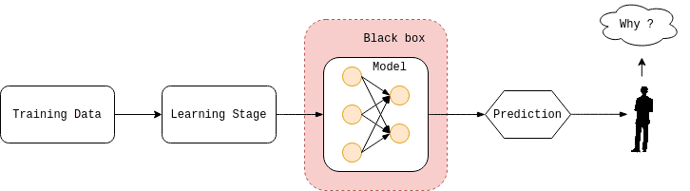
Demystifying the concept of eXplainable (XAI) AI

Slide 4
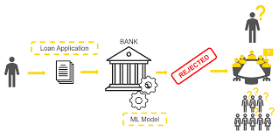
Demystifying the concept of eXplainable (XAI) AI : Case Study

Slide 5
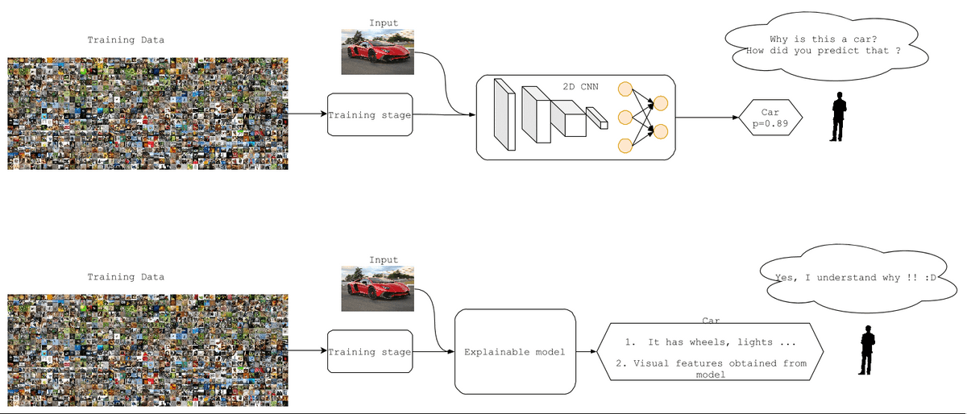
Case Study : Audience Understanding

Slide 6

Right to explanation
The “right to explanation” is a term used by the European Parliament and Council in the General Data Protection Regulation (GDPR) . This term is often mentioned in regard to XAI methods and requires a data controller to explain how the mechanism reached a decision. This part of the GDPR was created with an intent to prevent using the systems what decision cannot be interpreted by the human (like deep neural networks).
The goal is to avoid discrimination and ethical/financial biases in such systems.

Slide 7
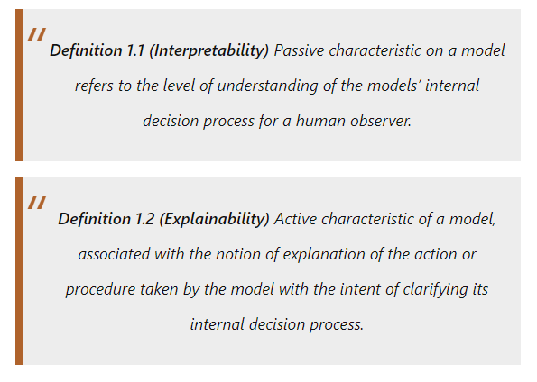
Interpretability vs Explainability

Slide 8

Need of XAI
Fairness- Can it be verified that model’s decisions are fair over the protected group ?
Trust – How confident are the users in working with the system?
Transparency – Do stakeholders understand the model’s decision in terms of formats and language ?
Causality – Do the predicted changes in the output due to input perturbations also occur in the actual system ?
Reliability – How robust the system performance against the changes in parameters and inputs ?

Slide 9
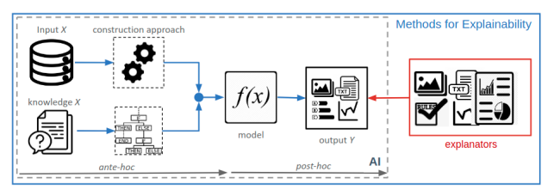
Taxonomy of XAI methods

Slide 10
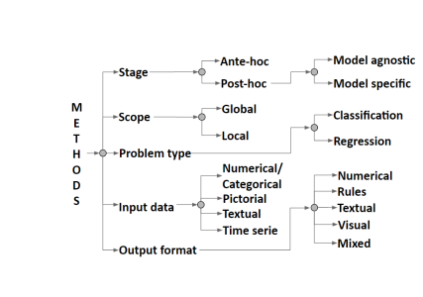
Classification of the XAI methods into hierarchical system
Figure : Classification of XAI methods into hierarchical system
Image source :Vilone, G., & Longo, L. (2021). Classification of explainable artificial intelligence methods through their output formats. Machine Learning and Knowledge Extraction, 3(3), 615-661.

Slide 11
Model Agnostic vs Model Specific
Model Specific | Model Agnostic
Model specific approaches work based on the details of the specific structures of the machine learning or deep learning model which is applied. These techniques are explicitly used for a specific model architecture, like say a specific convolutional network model CNN. These approaches exploit the internals of the machine learning model like the neural network and uses reverse engineering approach to provide explanations of how the specific DL or ML algorithm is giving the relevant decision. E.g.: guided back propagation, GRAD-CAM, Score CAM and Grad-CAM++ | Model agnostic methods do not take into account the structure of the model. They can be applied to any machine learning algorithms and work on the black box model approach. They obtain explanations by perturbing and mutating the input data and obtaining sensitivity of the performance of these mutations with respect to the original data performance. These give interesting insights into the relative localized region of the input which is giving a higher sensitivity. E.g. : SHAPley values, and LIME
Note This distinction is about whether the method works for all types of models (model-agnostic) or only specific ones

Slide 12
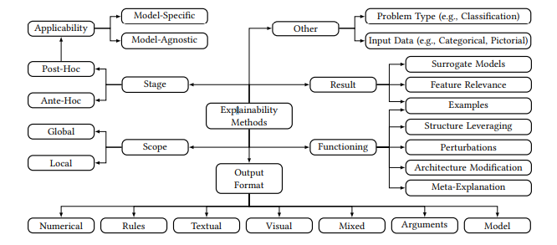
Four Approaches

Slide 13
Functioning based approach
The term functioning means: the way the explainability method extract the information from the model.
  Local Perturbation: changes in inputs to observe changes in the output
  Leveraging structure works by exploiting the properties of the model (e.g., examining the gradients of the neural network)
  Meta explanations: aggregating information from the other approaches
  Architecture modifications: changing the model’s infrastructure.
  Examples: picking or distilling the examples (e.g., training set)

Slide 14
Result based approach
This approach takes the result of an explainability method as the essential constituent for its classification.
Term Result means – the semantics of the explanations produced.
  Feature importance : indicating the features that contribute the most/least.
  Surrogate Model: building the models that is inherently understandable .
  Best suited for : especially useful for people trying to decide which explainability method to use in an application. These people usually have a good idea of what kind of explanation the application's users need. For instance, examples and feature importance attributions are something that, in many cases, one can easily and quickly understand without much background in ML. Surrogate models, however, are rather something for people with a solid background in ML, who know how to probe such systems.

Slide 15
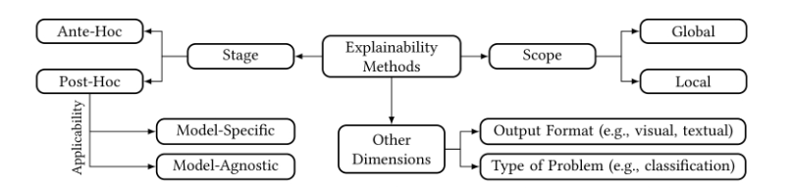
Conceptual Approach
This approach splits up the classification of explainability methods into several distinct conceptual dimensions that sometimes have hierarchical levels
Best Suited for : people who want to get a solid overview of the XAI landscape as a whole, for instance, to work on XAI topics themselves

Slide 16
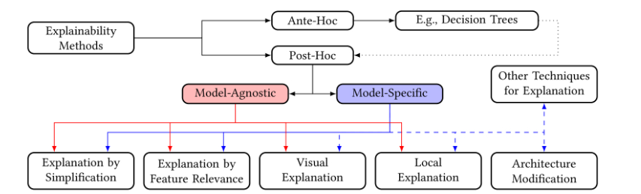
Mixed Approach
This approach is hybrid of all the above approaches.
Best Suited for : The mixed approach has its strength in combining the most important distinctions when it comes to explainability methods. For this reason, this approach is, in our eyes, best suited for people new to XAI

Slide 17
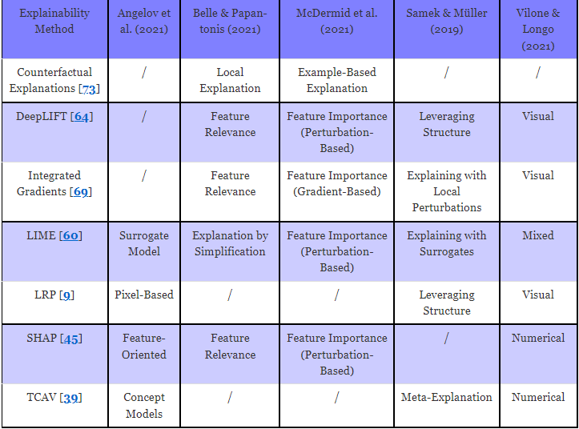
Popular explainability methods classified by the reviewed taxonomies
Table : Differences in the Classifications

Slide 18
SHAP ( SHapley Additive exPlanations ) Overview
SHAP framework, or the SHapley Additive exPlanations (SHAP) comes with explainers and adopts model-agnostic method to explain how different features influence the outcome thrown by the machine learning model. It assigns values to features in a prediction, revealing their contributions to the model's output. SHAP enables us to identify the driving factors behind AI decisions, making them more interpretable and trustworthy.
Case Scenario:
ML task of predicting product sales.
You model product sales prediction, and let’s say that we build using Multiple Linear Regression.
Result : From the prediction, you gather that the model has predicted a sale of 700 units. Now, how do you explain the prediction result of this model?
SHAP framework is used to explain how the model arrived at the Predictive results.
Tracing our way back to the product prediction, we also need to consider the average prediction for that product, which is say 950 units. How did each of the feature value contribute to the prediction (700 units) as compared to average prediction then helps understand the model behavior.

Slide 19
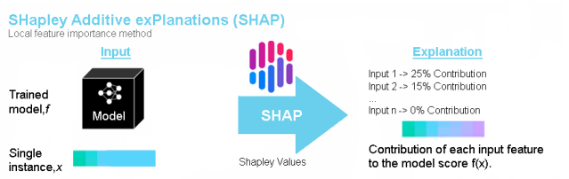
SHAP ( SHapley Additive exPlanations ) : Audience Intuitiveness
Figure : Pipeline of SHAP

Slide 20
Calculating the Shapley Values for a Feature
With the Shapley value, you can explain what every feature in the input data contributes to every prediction.
For instance, in the case of Product sales prediction, let us assume that 5 features in the input data are brought into perspective.
The feature values here are Discount Rate 10%, Price, Free Delivery, Past Purchase, and Stock.
Every feature contributes to this output of 700 – for example, Discount Rate 10% – 400, Free delivery – 150, Stock – 130, Price – -120 Past Purchase – 140 add up to give out the model output 700.
Now What ?
We need to calculate the Shapley value for each one of these features.
When we say Shapely value, we arrive at the average marginal contribution of a specific feature acquired using various possible coalitions.
In this case, let’s consider the Shapley value of ‘Discount Rate 10%’. The possible coalitions for determining the Shapley value for Discount Rate 10% are taken into consideration, captured by the image in the next slide.

Slide 21
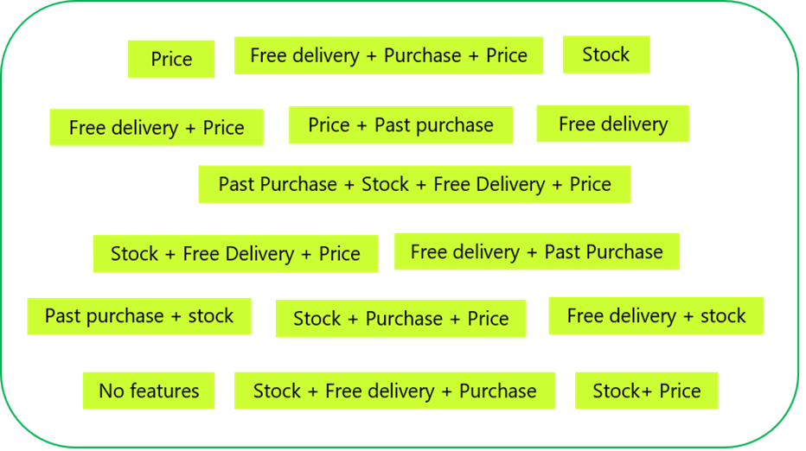
The product sale prediction is performed for every one of the coalitions captured above with Discount Rate 10% feature, as well as without that feature value. When you take the difference, you arrive at the marginal contribution. And when you arrive at the average pertaining to marginal contributions, you get the Shapley value.

Slide 22
References
https://theaisummer.com/xai/
Vilone, G., & Longo, L. (2021). Classification of explainable artificial intelligence methods through their output formats. Machine Learning and Knowledge Extraction, 3(3), 615-661.
https://www.saksoft.com/blog/how-to-implement-explainable-ai-xai-with-shap-framework/
https://blog.goodaudience.com/holy-grail-of-ai-for-enterprise-explainable-ai-xai-6e630902f2a0.
Machlev, R., Heistrene, L., Perl, M., Levy, K. Y., Belikov, J., Mannor, S., & Levron, Y. (2022). Explainable Artificial Intelligence (XAI) techniques for energy and power systems: Review, challenges and opportunities. Energy and AI, 100169.
Speith, T. (2022, June). A review of taxonomies of explainable artificial intelligence (XAI) methods. In 2022 ACM Conference on Fairness, Accountability, and Transparency (pp. 2239-2250).
Schwalbe, G., & Finzel, B. (2023). A comprehensive taxonomy for explainable artificial intelligence: a systematic survey of surveys on methods and concepts. Data Mining and Knowledge Discovery, 1-59.

Slide 23

Thank you

